Slide 1


Timothy Ongaba
MSc. Biomedical Sciences
Nottingham Trent University
Bioinformatics hybrid placement with UEA

Slide 2

Tasks
RScript
Results
Discussion
AOB
Rank significantly enriched genera in each cancer type by P value not alphabetical order
Convert from positive read counts to relative abundance for respective genera
Carry out a PCA between the cancer-type genera - add percentage contribution of the principle components to the observed differences
Backtrack which samples are most dissimilar and why(read counts?)
Add a random seed (8)for the tSNE plot as quality control for reproducibility

Slide 3
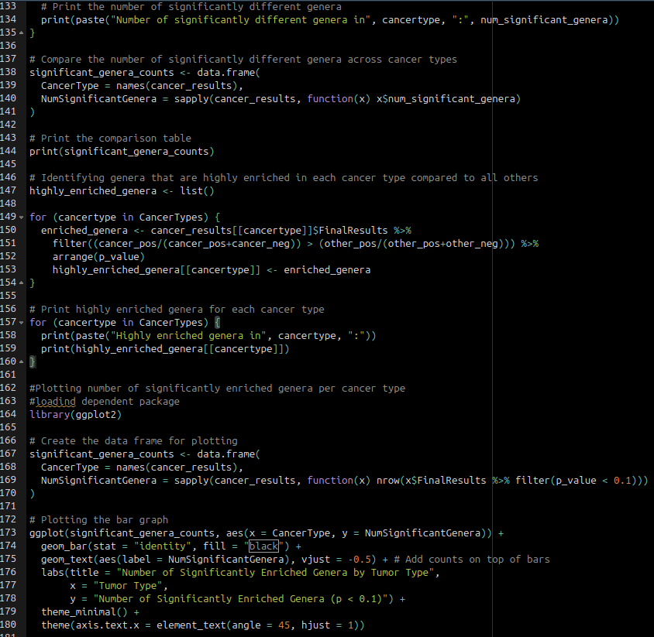


Tasks
RScript
Results
Discussion
AOB
Sig Genera comparison
Bar plot

Slide 4
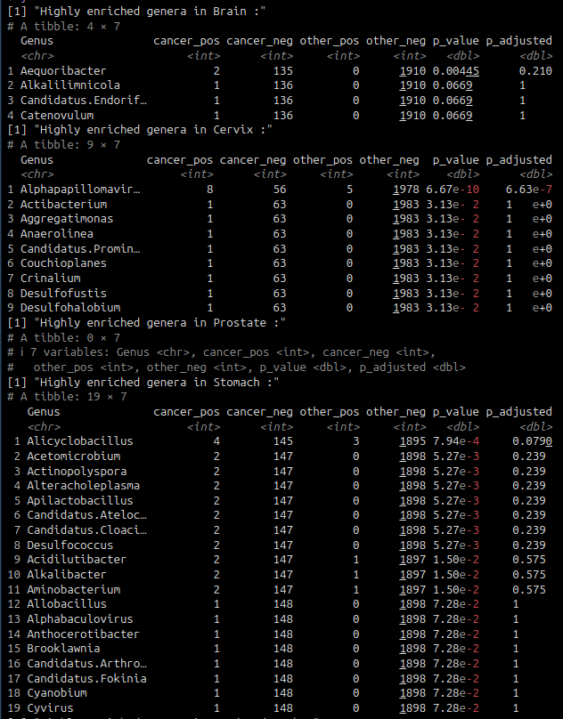
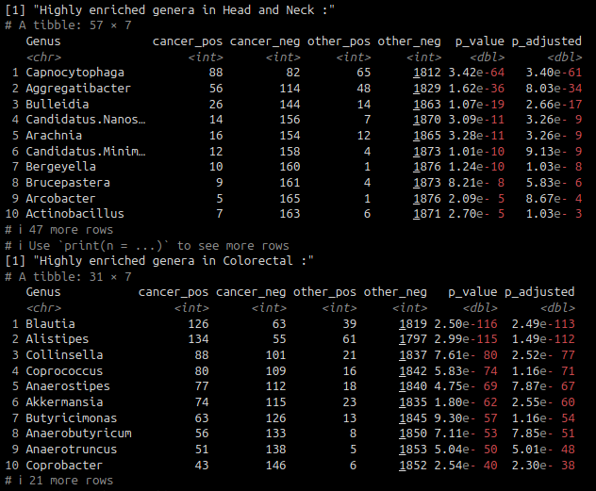
Tasks
RScript
Results
Discussion
AOB
Brain, Cervix, Prostate & Stomach
Head&Neck and Colorectal
Table1| Top significantly enriched genera by cancer type

Slide 5
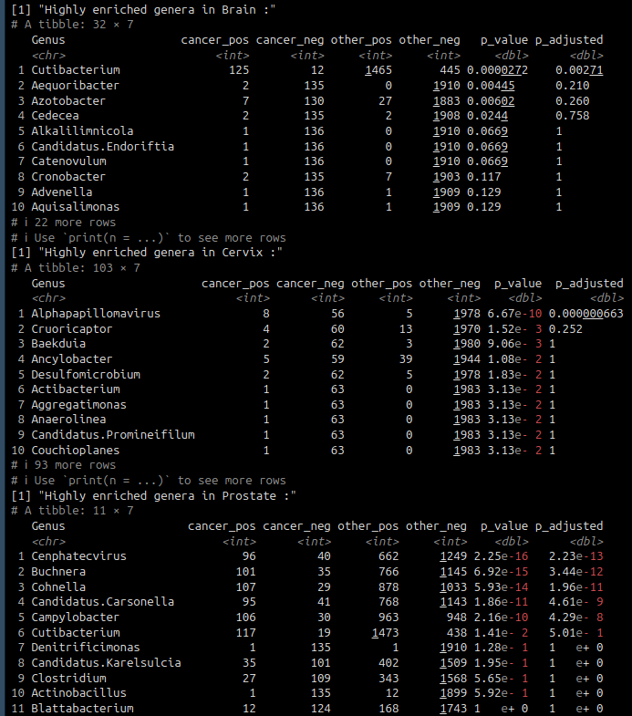
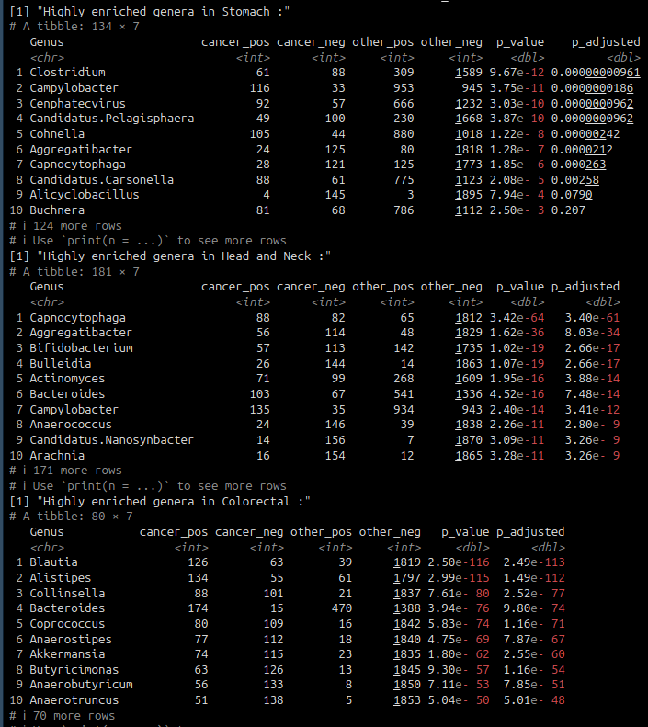
Tasks
RScript
Results
Discussion
AOB
Table1| Top significantly enriched genera by cancer type

Slide 6
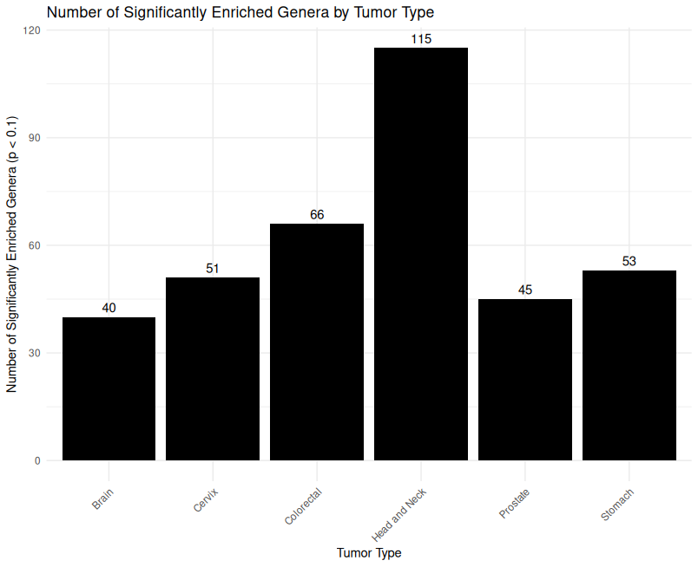
Tasks
RScript
Results
Discussion
AOB
Fig1| Head&Neck have the most significantly enriched genera

Slide 7
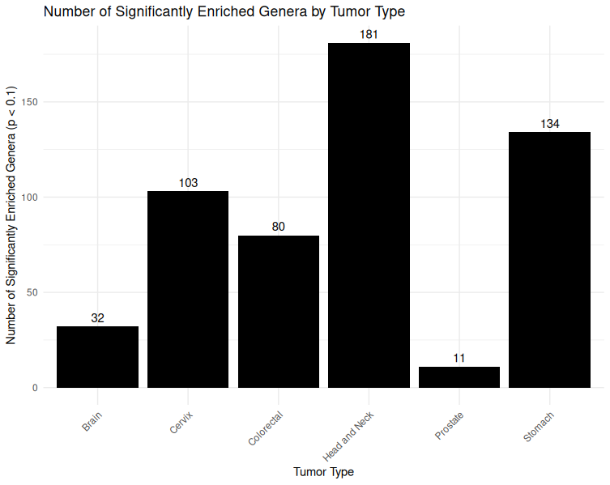
Tasks
RScript
Results
Discussion
AOB
Fig1| Head&Neck have the most significantly enriched genera

Slide 8
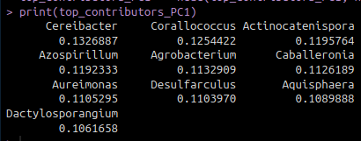
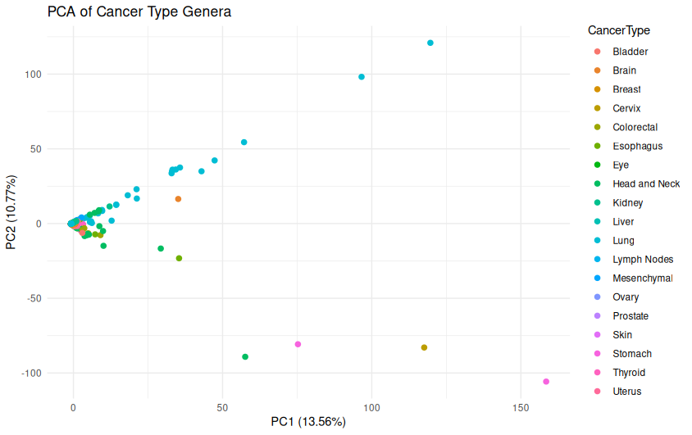
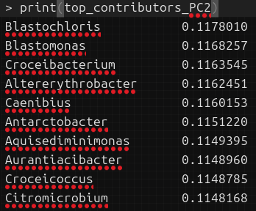
Tasks
RScript
Results
Discussion
AOB
Fig2| Stomach and Lung have the most divergent genera compositions

Slide 9
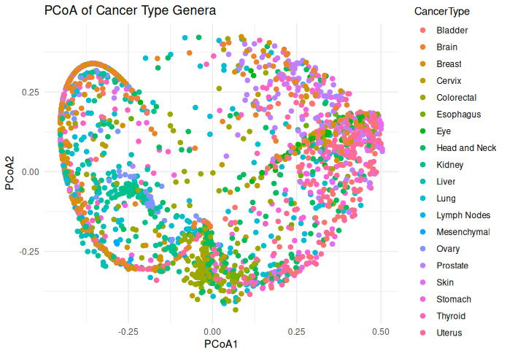
Tasks
RScript
Results
Discussion
AOB
Fig2| Colorectal and Thyroid/Uterus/Stomach are most different composition

Slide 10
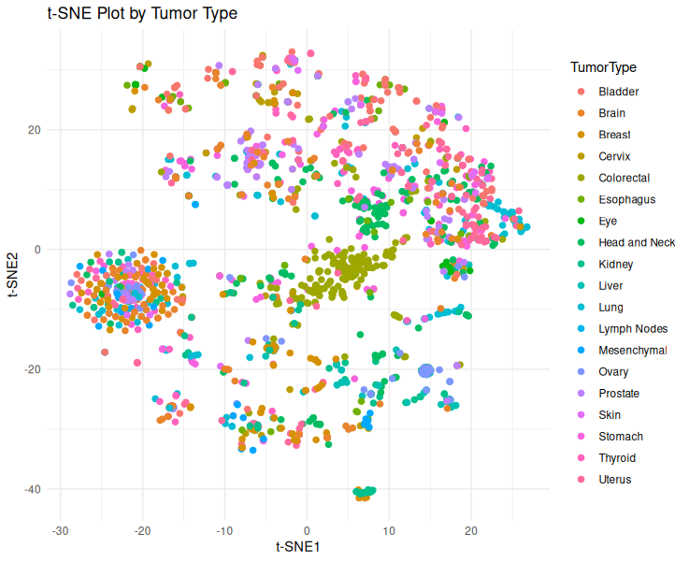
Tasks
RScript
Results
Discussion
AOB
Fig3| Breast/thyroid/head&neck have almost similar genera composition

Slide 11
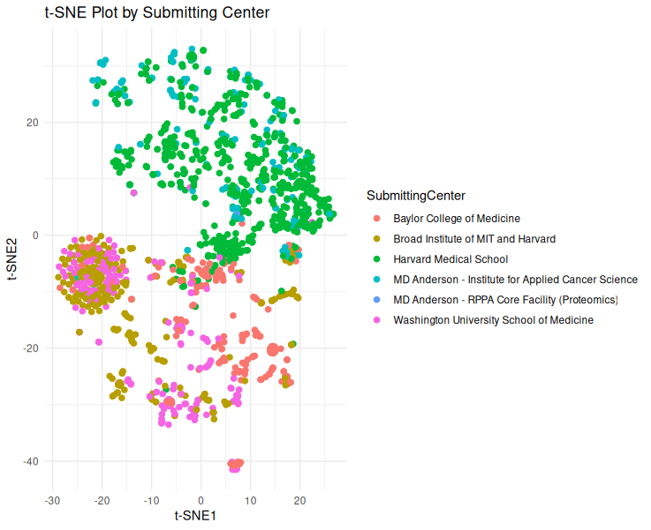
Tasks
RScript
Results
Discussion
AOB
Fig4|Broad institute of MIT and Harvard MS samples had similar genera composition

Slide 12
Tasks
RScript
Results
Discussion
AOB
Colorectal and Head&Neck have most contributing genera. More in Colorectal
Colorectal has most relatively +ve counts per genus
Difference in tSNE by cancer type and submitting centre ~ difference in technique/batch-to-batch

Slide 13
Tasks
RScript
Results
Discussion
AOB
Research grant schemes
CRUK Senior Cancer Research Fellowship
Prostate Cancer UK(no phd studentships)
Medical Research Council(no PhD studenships supported)
Biotechnology and Biological Sciences Research Council
The Welcome Trust
The Institute of Cancer Research (not exactly a funding body)
National Institute for Health Research

